Slide 1


CONVERTABLE CHAIR,IRON BOARD AND LADDER
BATCH MEMBERS Batch mentor
Sujith. R Mr.M.Karthe
Naveenkumar. M
Pradeesh.N

Slide 2
ABSTRACT
The invention relates to furniture, and especially relates to a multifunctional ladder chair.
A technical problem to be solved is providing a multifunctional ladder chair having functions of a ladder, a chair and iron board.
The multifunctional ladder chair has the advantages of convenient transition among various functions, safety, reliability, economy, utility, beauty, comfortableness, and convenient dismounting and transportation.

Slide 3
INTRODUCTION
They are commonly made of metal, wood, or fiberglass, but they have been known to be made of tough plastic.One of the basic pieces of furniture, a chair is a type of seat.
Used in a number of rooms in homes in schools and offices and in various other workplaces, chairs may be made of wood, metal, or synthetic materials, and either the seat alone or the entire chair may be padded or upholstered in various colors and fabrics.

Slide 4
WORKING PRINCIPLE
The invention relates to a furniture element which is convertible from a chair into an ironing table and ladder.
By a simple handling, the back and seat of the chair connectable to each other can pivot and slide along a floor standing in such a way that an ironing board is produced after the alignment
The invention makes it possible to integrate the ironing table into usual furniture.

Slide 5
MATERIALS USED
FRAME
SHEET METAL
PLYWOOD

Slide 6
METAL FRAME
The metal frame is generally made of mild steel bars for machining, suitable for lightly stressed components including studs, bolts, gears and shafts.
It can be case-hardened to improve wear resistance. They are available in bright rounds, squares and flats, and hot rolled rounds

Slide 7
SHEETMETAL
Sheet metal is metal formed by an industrial process into thin, flat pieces.
It is one of the fundamental forms used in metalworking and it can be cut and bent into a variety of shapes.
Sheet metal is available in flat pieces or coiled strips.

Slide 8
PLY WOOD
Plywood is a material manufactured from thin layers or "plies" of wood veener that are glued together with adjacent layers having their wood grain rotated up to 90 degrees to one another
It is an engineer wood from the family of manufactured boards which includes medium density fibreid(MDF) and partical board.

Slide 9
Cost estimation
SL.NO | DISCRIPTION | COST Rs:
1 | FRAME | 1800
2 | SHEET METAL | 800
3 | PLY WOOD | 400
4 | TOTAL | 3000

Slide 10
ADVANTAGES
The multifunctional ladder chair has the advantages of convenient transition among various functions, safety, reliability, economy, utility, beauty, comfortableness, and convenient dismounting and transportation.
The chair legs and the backrest columns of the multifunctional ladder chair adopt multilayer tubes.

Slide 11
APPLICATION
It is very helpful to use in small places.
It is useful for middle class peoples.
Used in homes,office,shops,companies,etc…

Slide 12
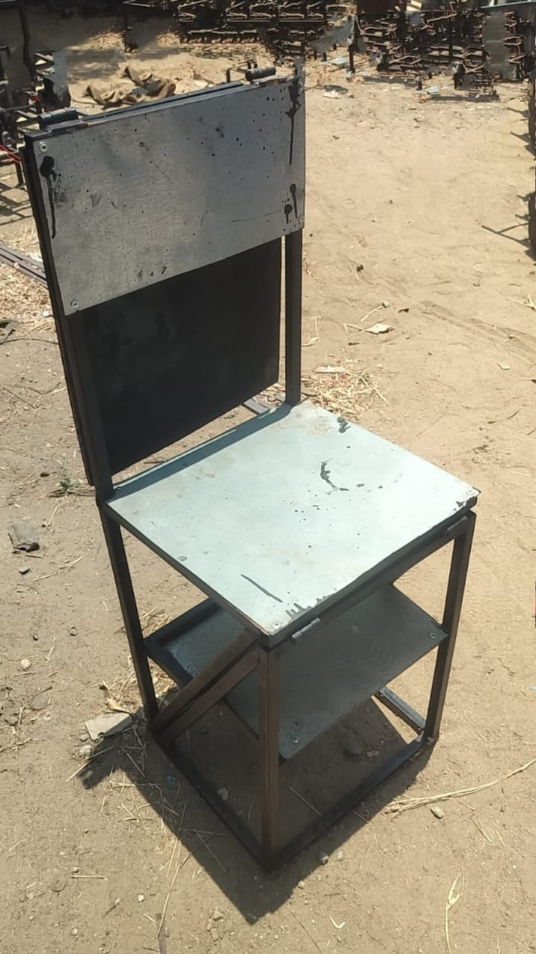
Final Fabrication

Slide 13
CONCLUSION
The concept of Chair,Iron board and Ladder helps the people in floor space, comfort, and Economical price.
The Chair,Iron board and Ladder conversion makes multi-purpose chair is light in weight and minimum cost in that order.

Slide 14
THANK YOU

